Slide 1

Universal Medical Form Reader
Setting Up New System and Environment For Executing the Reader (Anaconda, Python, and R) on Windows
This document was written in July 2021

Slide 2
Universal Form Reader
Contents
Install Anaconda (Python) on Windows.......................................................................................... 3
Create a new Anaconda Environment using command line .......................................................... 15
Test your installation by importing the installed packages ...................................................... 17
Make sure that Spyder is installed .............................................................................................. 22

Slide 3
Universal Form Reader
Install Anaconda (Python) on Windows
What is Anaconda?
Anaconda is a package manager, an environment manager, and Python distribution that contains a collection of many open source packages (numpy, scikit-learn, scipy, pandas to name a few). If you need additional packages after installing Anaconda, you can use Anaconda's package manager, conda or pip to install those packages. This is highly advantageous as you do not have to manage dependencies between multiple packages yourself.
Note: You can use your current system or step a machine for this task.
These are certain requirements mandatory for any system running pdf reader.

Slide 4


Universal Form Reader
Install Anaconda (Python) on Windows
Step1. Download Anaconda. Go to the Anaconda Website, select products, and then choose Individual Edition.

Slide 5
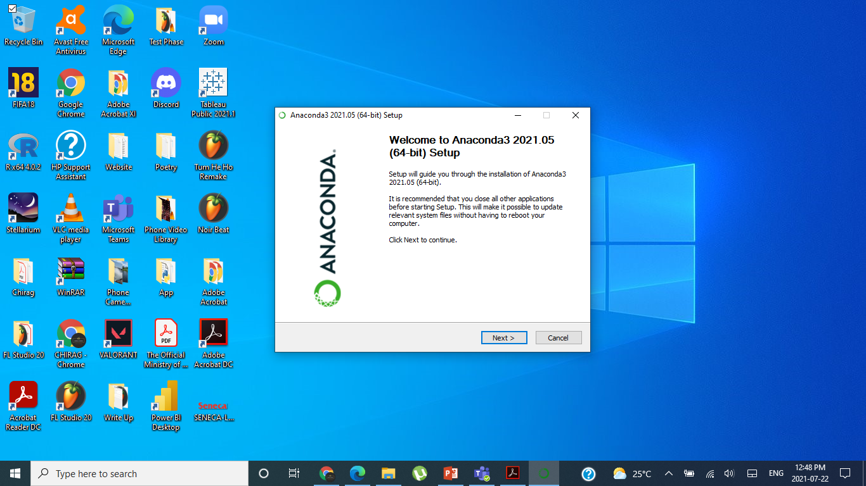
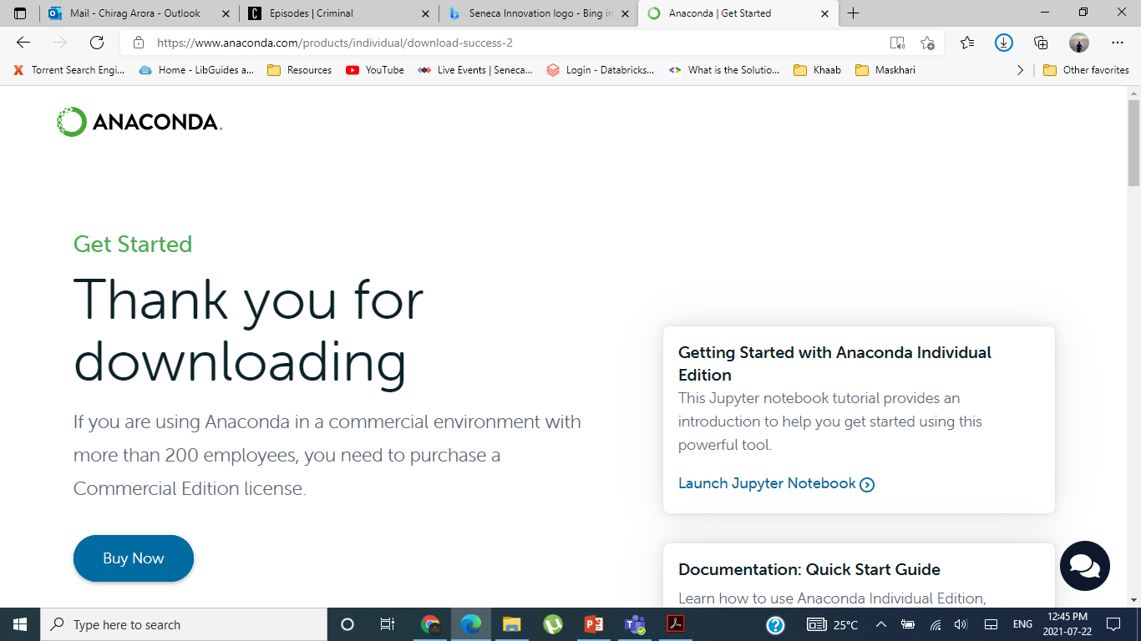
Universal Form Reader
Install Anaconda (Python) on Windows
Step2. Locate your downloaded file (.exe), and then run the file (you can run the file as administrator). When the screen below appears, click on Next.

Slide 6
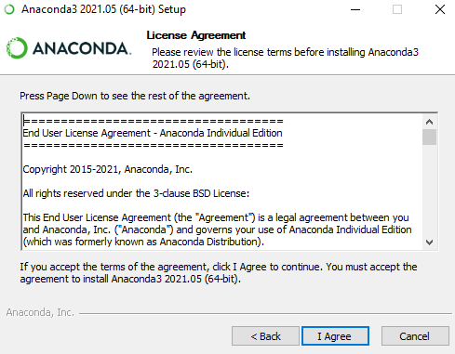
Universal Form Reader
Install Anaconda (Python) on Windows
Step3. Read the License Agreement and click on I Agree.

Slide 7
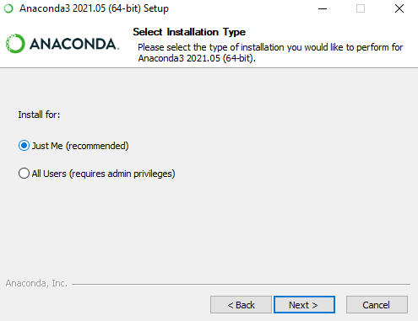
Universal Form Reader
Install Anaconda (Python) on Windows
Step4. Choose either Just Me (recommended) or All Users.

Slide 8
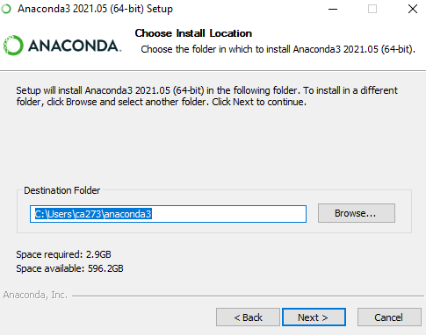
Universal Form Reader
Install Anaconda (Python) on Windows
Step5. Please make a note of your installation path location

Slide 9
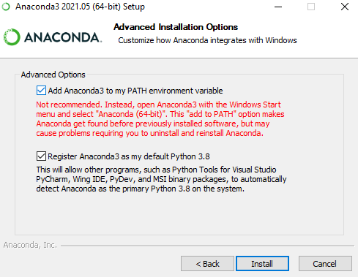
Universal Form Reader
Install Anaconda (Python) on Windows
Step6. This is an important part of the installation process. The recommended approach is not to check the first box to add Anaconda to your path. This means you will have to use Anaconda Navigator or the Anaconda Command Prompt (located in the Start Menu under "Anaconda") when you wish to use Anaconda (you can always add Anaconda to your PATH later if you don't check the box). Click on Install.

Slide 10
Universal Form Reader
Install Anaconda (Python) on Windows
Step7. Click on Next.

Slide 11
Universal Form Reader
Install Anaconda (Python) on Windows
Step8. You can install PyCharm but it is not recommended. You can skip the installation with the skip button. The two check boxes are also optional at the end screen. Click on Finish.

Slide 12
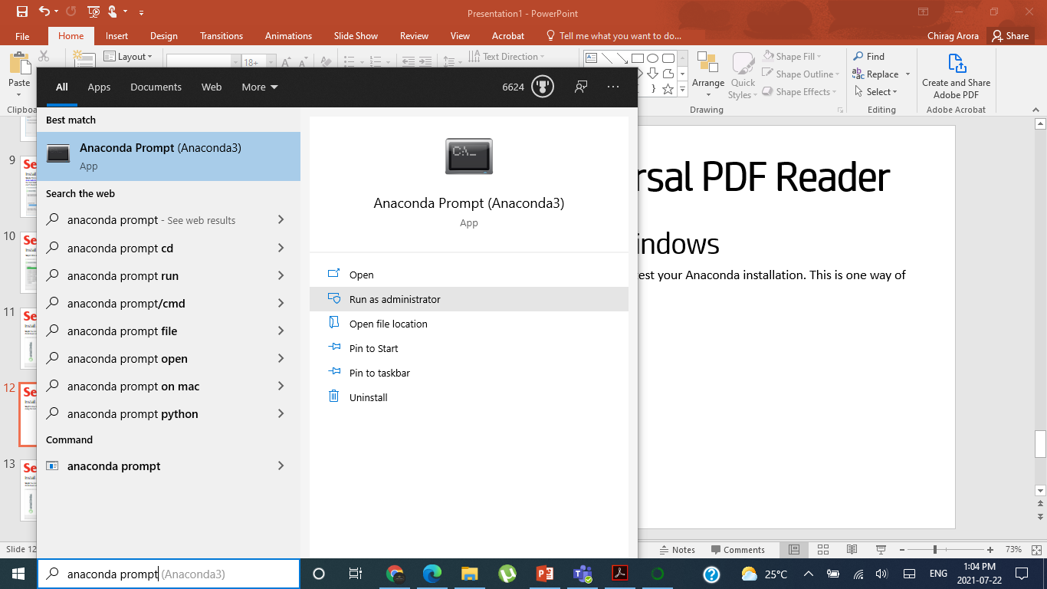
Universal Form Reader
Install Anaconda (Python) on Windows
Step9. How can you test your installation? There are many ways to test your Anaconda installation. This is one way of doing the test. Locate Anaconda Prompt.

Slide 13
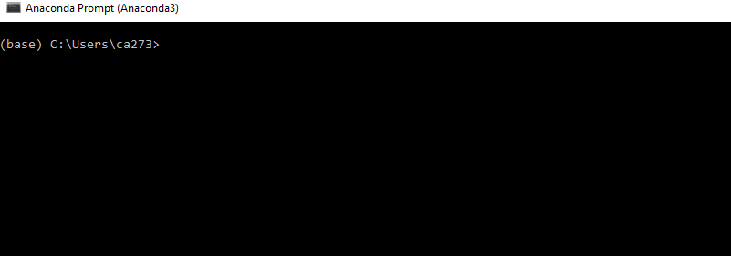
Universal Form Reader
Install Anaconda (Python) on Windows
Step10. Note it open the (base)environment.

Slide 14
Universal Form Reader
Install Anaconda (Python) on Windows
Step11. Type the commands below
conda -V
then
python

Slide 15
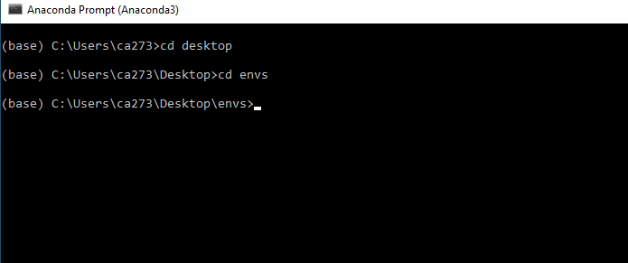
Universal Form Reader
Create a new Anaconda Environment using command line
Step12. Create a new Anaconda environment. There Command-Line way and Anaconda Navigator way. I will explain here the Command-Line way.
Step13. Download and extract "envs.zip" from the course Microsoft Teams.
Step14. On Windows, open the installed "Anaconda Prompt" to run this command. You can use a terminal window to run the command on macOS and Linux.

Slide 16
Universal Form Reader
Create a new Anaconda Environment using command line
Step15. Open Anaconda Prompt and locate the envs folder/directory.
Step16. Execute the following command. conda env create -f environment.yml

Slide 17
Universal Form Reader
Test your installation by importing the installed packages
Step17. Open Anaconda Navigator. Make sure the "DSB" environment is selected.

Slide 18
Universal Form Reader
Test your installation by importing the installed packages
Step18. Launch Anaconda prompt and activate it using the following Windows command: "conda activate DSB" or the following MacOS / Linux command: "source activate DSB"

Slide 19
Universal Form Reader
Test your installation by importing the installed packages
Step19. Run python

Slide 20
Universal Form Reader
Test your installation by importing the installed packages
Step20. Write the following install statements
pip install pandas
pip install pdfquery
pip install xml.etree.ElementTree
pip install pdfminer
pip install numpy

Slide 21
Universal Form Reader
Test your installation by importing the installed packages
Step21. Write the following import statements and You should see no error messages
import pandas
import pdfquery
import xml.etree.ElementTree
import pdfminer
import numpy

Slide 22
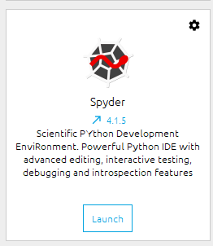
Universal Form Reader
Make sure that Spyder is installed
Step22. The Spyder should be installed after you run the command.
Step23. In case it does not show launch, install it by clicking Spyder. Click on Home, make sure your DSB is selected.

